Slide 1
BRITISH AIRWAYS
PREDICTIVE MODEL AND RESULTS

Slide 2
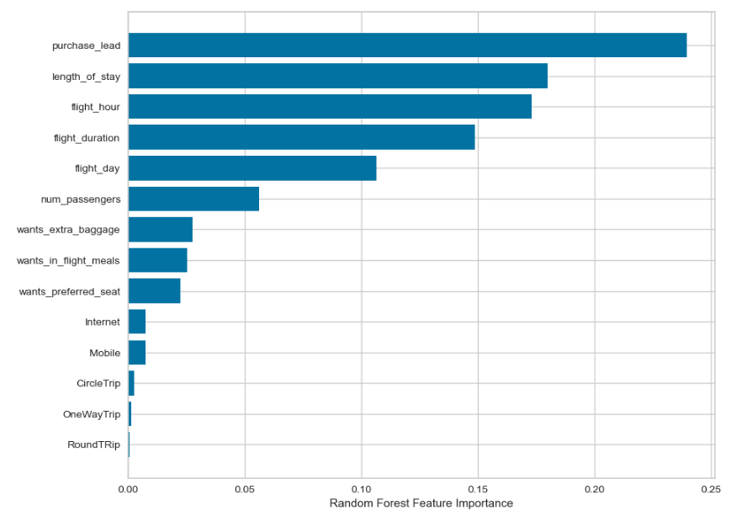
PREDICTIVE MODELLING RESULTS
Recall Rate 60%
Precision
61%
Accuracy
62%
Top features that can drive successful flight bookings are:
Purchase lead
Length of Stay
Flight Hour
Flight Duration
Flight Day

